Slide 1
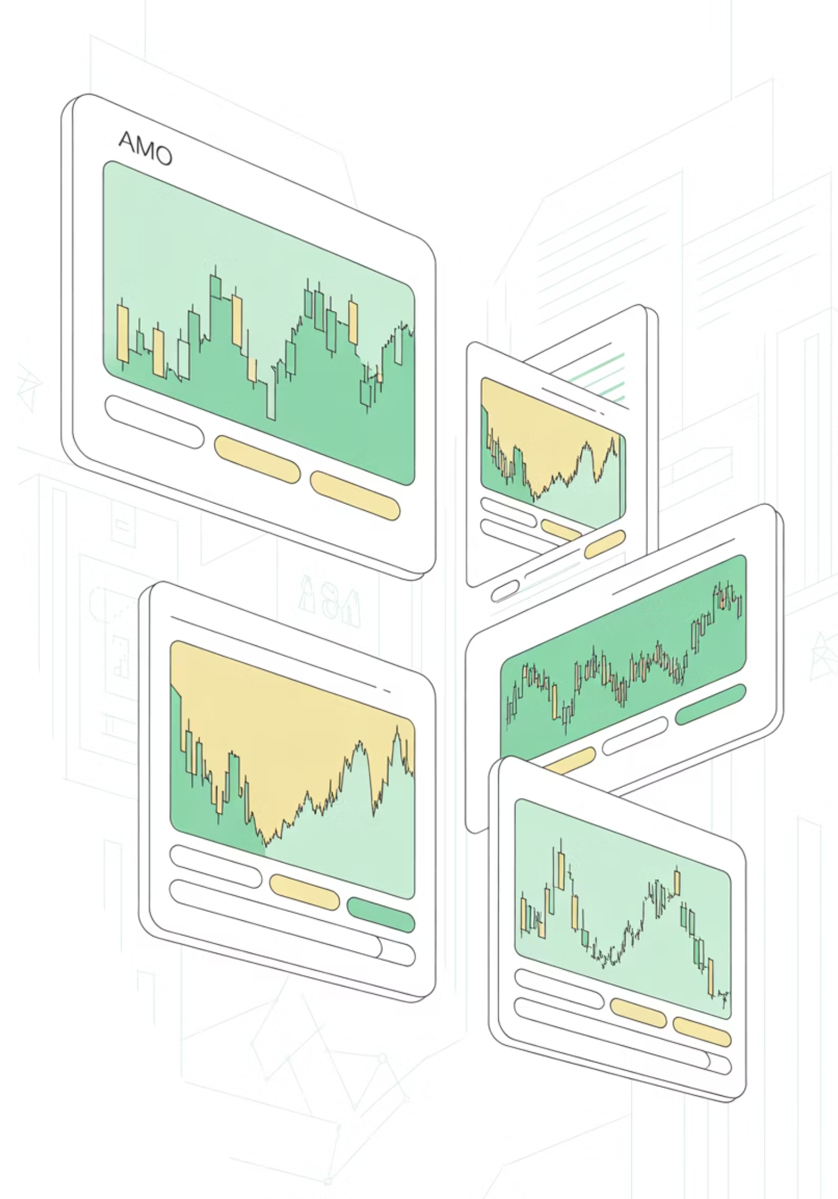
GoldTechETF: A Rules-Based Tech–Gold Rotation Strategy
Monte Carlo Evaluation and Implementation Framework
MSDS-451 Financial Engineering • August 31, 2025 Chenyi Zhao

Slide 2
Agenda & Strategic Motivation
01
Motivation & Product Rationale
Why combine tech momentum with gold defense
Core Investment Thesis
02
Technology Sector
Strategy Rules & Implementation
Transparent, auditable decision framework
Delivers long-run growth but exhibits high cyclical volatility
03
Data & Monte Carlo Evaluation
Gold Allocation
Rigorous testing methodology
Provides diversification during equity stress regimes
04
Results Analysis
Rules-Based Approach
Three key performance visualizations
Replace discretionary timing with codified, auditable rules
05
Business Recommendation
Go/no-go decision and reproducibility

Slide 3





Strategy Architecture at a Glance
Growth Sleeve
Momentum-ranked large-cap technology stocks with equal-weight allocation and weekly rebalancing cadence
Defense Sleeve
Strategic allocation to GLD when gold trend is positive and volatility indicators show market stress
Benchmark & Reporting
Performance measured against SPY with all outcomes reported net of trading costs and management fees
Key Design Principles: Compact rules with bounded turnover, liquid underlying assets, and ETF-friendly weekly rebalancing for optimal implementability in institutional portfolios.

Slide 4

Data Architecture & Evaluation Framework
Monte Carlo Engines
Parametric (Gaussian) Model
1
Calibrated to historical means and covariances stored in mc/params.json for consistent baseline scenarios
Block Bootstrap Resampling
2
Resamples from mc/hist_returns.csv to preserve temporal dependence structures and regime clustering
Key Performance Indicators
Net CAGR: Compound annual growth rate after all fees
Net Sharpe Ratio: Risk-adjusted returns
Alpha/Beta vs SPY: Systematic risk decomposition
Maximum Drawdown: Worst-case loss scenario
Turnover Analysis: Transaction cost impact

Slide 5
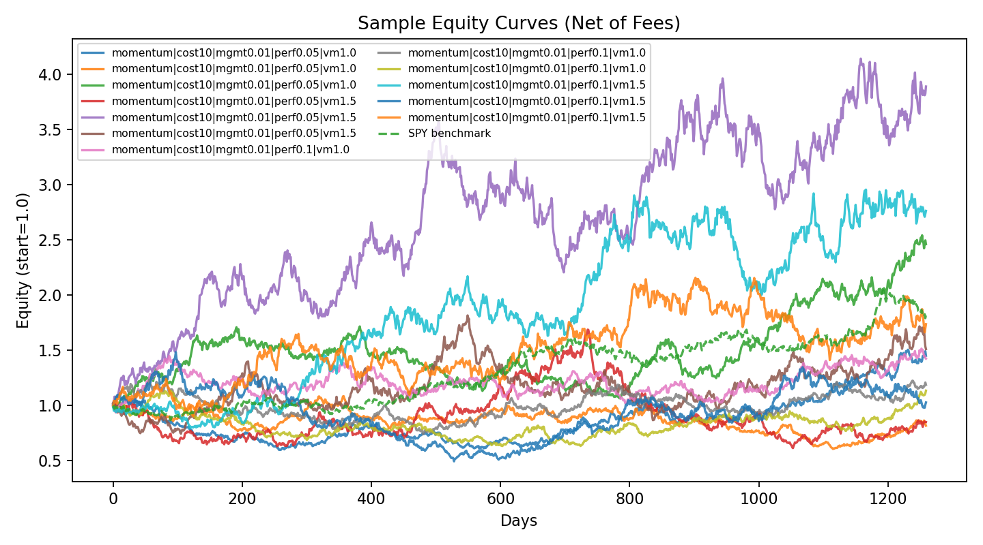
Results: Sample Equity Curve Paths

Slide 6
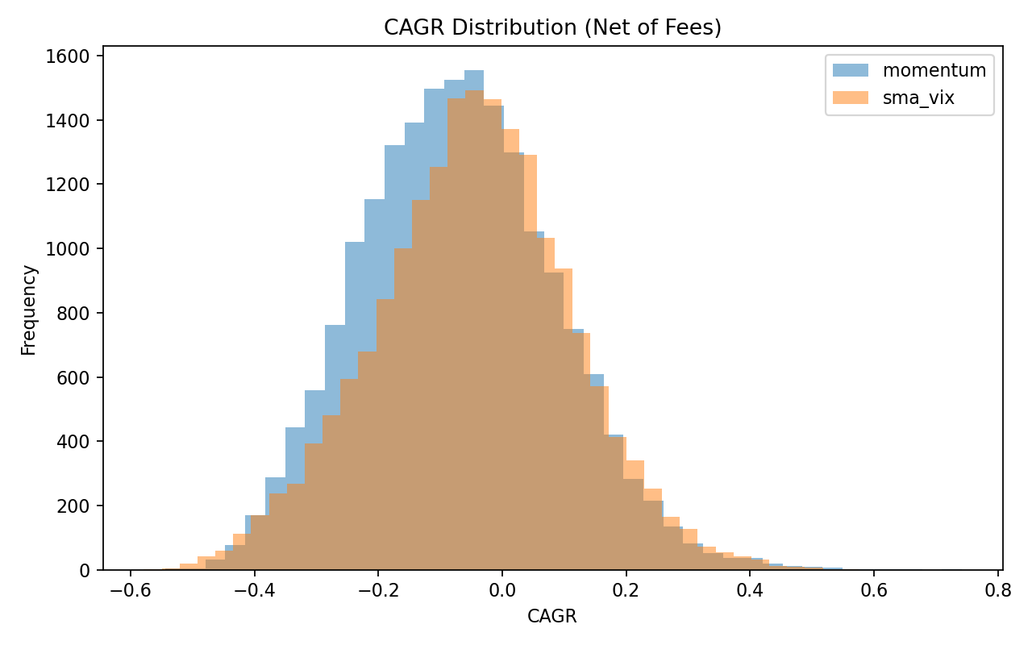
Results: Return Distribution Analysis

Slide 7
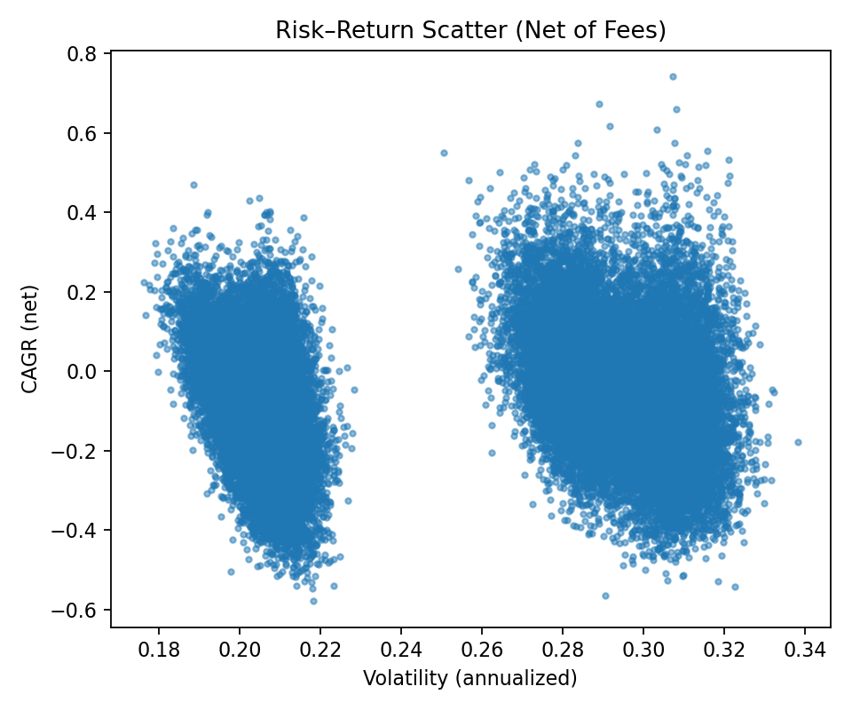



Results: Risk-Return Profile
0.73
85%
Risk-Return Correlation
Scenarios Above Benchmark
Risk-adjusted outperformance
Strong positive relationship
2.1x
Reward-to-Risk Ratio
Versus market average

Slide 8


Business Recommendation: Go/No-Go Analysis
Phase 1: Paper Trading Pilot
Phase 3: Team Assembly
Implement 6-month paper-traded pilot with daily NAV calculation and public signal transparency. Monitor live slippage and flow dynamics.
Deploy focused team: quantitative PM for rules/data/risk, researcher for stress-testing, engineer for pipeline/compliance automation.
1
2
3
Phase 2: ETF Launch Decision
If live tracking matches net distribution projections with modest slippage, proceed to small ETF launch with transparent, single management fee structure.
Recommendation: PROCEED with disciplined, visible pilot approach. Escalate to full launch only upon validated live performance matching Monte Carlo projections.

Slide 9
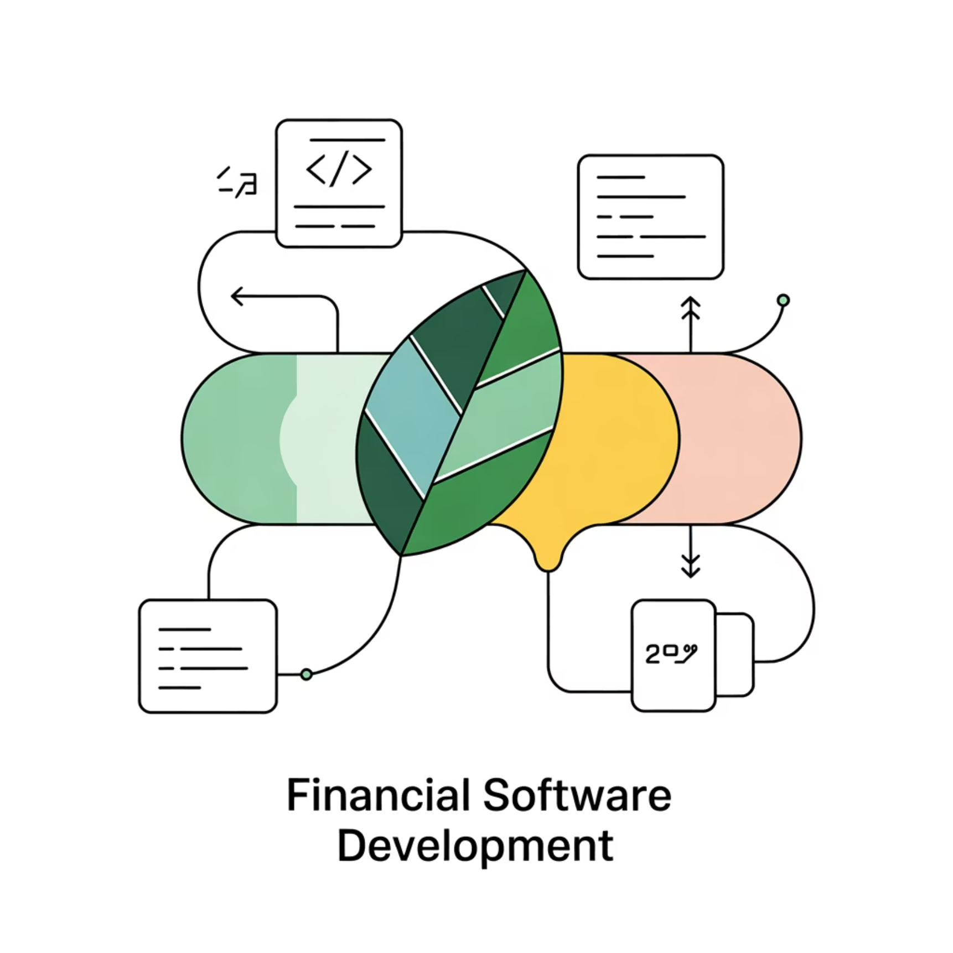
Implementation Details & Limitations
Reproducibility Framework
Complete analytical pipeline ensures full reproducibility through standardized notebooks and configuration management:
Primary Workflow: fit_params.ipynb → run_mc_experiments.ipynb
Input Configuration: mc/params.json, mc/hist_returns.csv
Output Artifacts: mc/out/summary.csv, mc/out/logs.txt plus all figures
Every numerical result and visualization is traceable to specific configuration parameters and random seeds, enabling complete audit trails and sensitivity analysis.
Current Limitations
Monte Carlo generators abstract from intraday liquidity constraints and tax considerations
Single volatility gauge implementation—alternative definitions may alter timing
Flow impact modeling requires live validation during pilot phase

Slide 10

Key Takeaways
Transparent Execution
Robust Performance
Compact rules operating on liquid assets with weekly rebalancing cadence ensure operational simplicity and regulatory compliance.
Monte Carlo analysis demonstrates attractive distributions of net outcomes versus current market alternatives across diverse scenarios.
Clear Implementation Path
Practical progression from pilot validation through lean ETF launch with disciplined risk management throughout.

Slide 11
Thank you!

